Slide 1
SOM CLIP Steps

Slide 2
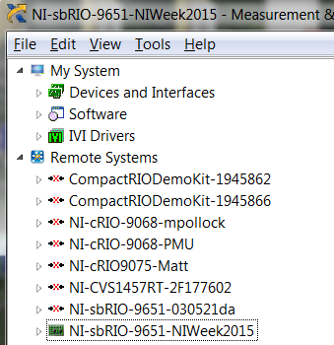
Connecting to SOM
Connect SOM directly using Ethernet Cable or USB to laptop/computer
Detect the name of the Module in MAX
Notes:
You can rename the sbRIO Name in MAX

Slide 3
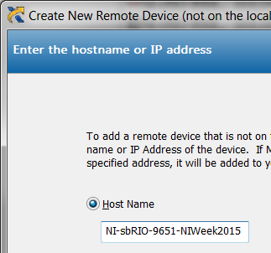
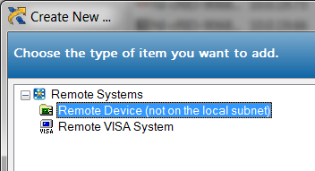
Connecting to SOM
Now you disconnect cable between laptop/computer
Connect SOM to Wireless
Find SOM in MAX by the name
Notes:
NI-sbRIO-9651-NIWeek2015

Slide 4
Connecting SOM Console using Putty and RS-232
Connect COM Console of SOM to Putty
Step 1: Hold Reset button for 5 seconds to start the board in safe mode and get output from console
Step2 :Using Settings ---- Baud Rate: 115200
Step 3: Check IP Address using ifconfig
Step 4 (Optional) : If you don't get the IP Address, run
a) /etc/init.d/networking restart
b) then ifconfig

Slide 5
Wireless Access Point
Instructions to setup wireless access point on SOM are listed below
Notes:
opkg update
ifconfig
wpa_cli status ...I am in Access Point Mode
ps | grep grep dhc
ps | grep dhc
cat /etc/udhcpd.wlan0.conf
vi /etc/udhcpd.wlan0.conf .... Save goes to cache...might not go to drive
sync ... Flushes disk buffer and caches
ps | grep dhc ...
kill 1626
ps | grep dhc
udhcpd /etc/udhcpd.wlan0.conf
ps | grep dhc
history

Slide 6
CLIP
CLIP provides interface between VHDL Code and LVFPGA Code
Two types of CLIPS
a) User Defined CLIP
b) Socketed CLIP
There can only be one socketed CLIP for each board
Notes:
Socket CLIP is the clip which defines I/O for the board
DIO’s, Voltage levels for the DIO such as LVCMOS etc.
Socketed CLIP also has timing constraints file

Slide 7
Socketed CLIP
Socketed CLIP abstracts underlying I/O for LVFPGA
It has three components
VHDL File
XML File
*.xdc or *.ucf constraints file

Slide 8
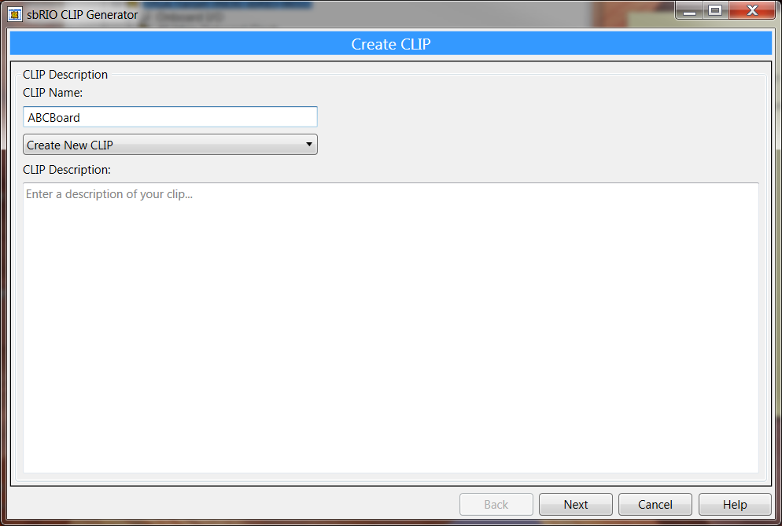
CLIP Generation Wizard
For System On Module (SOM), CLIP Generation Wizard automatically
Creates all the above 3 files with user input

Slide 9
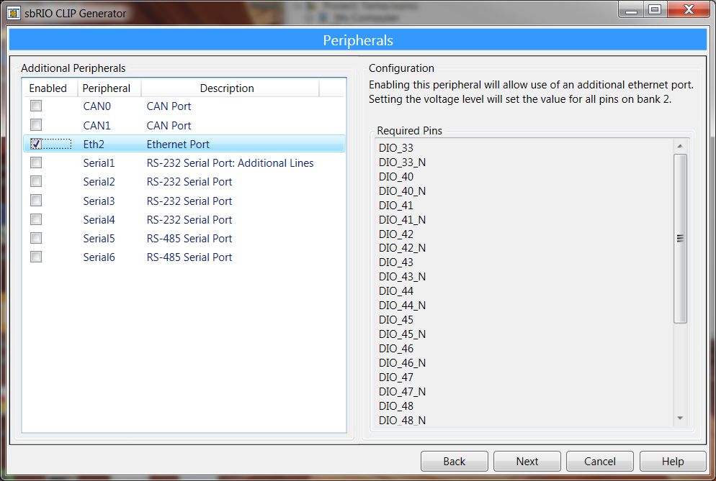
Step1: Peripherals

Slide 10
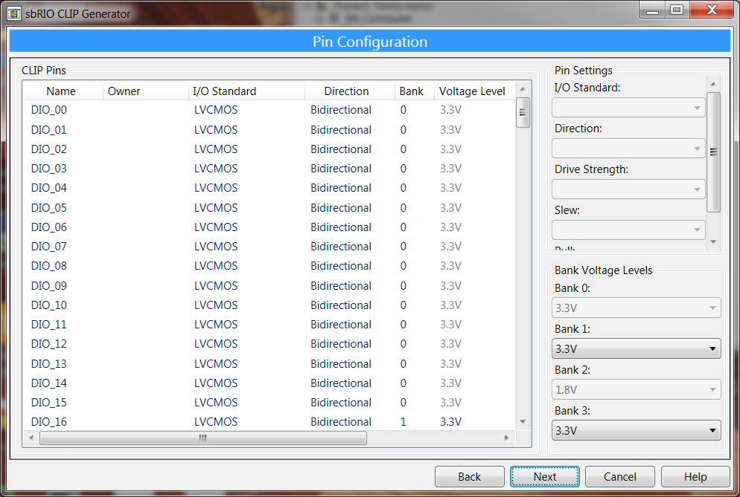
Step 2: Pin Configuration

Slide 11
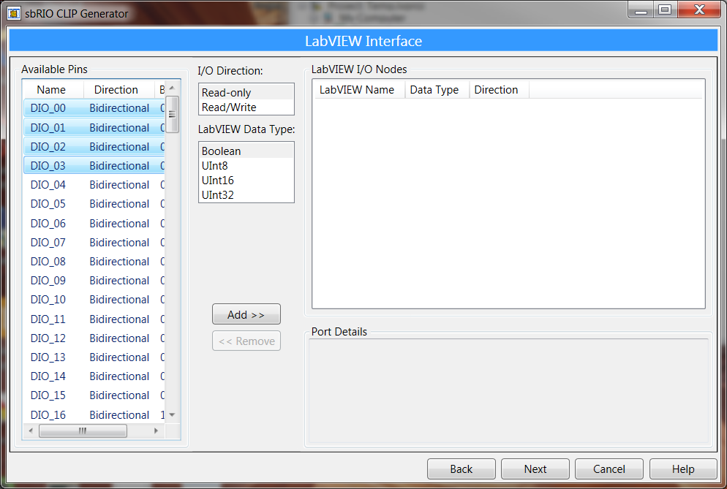
Step 3: Select Pins for LVFPGA
Notes:
You can select only the pins you are interested in programming with on LVFPGA Block diagram

Slide 12
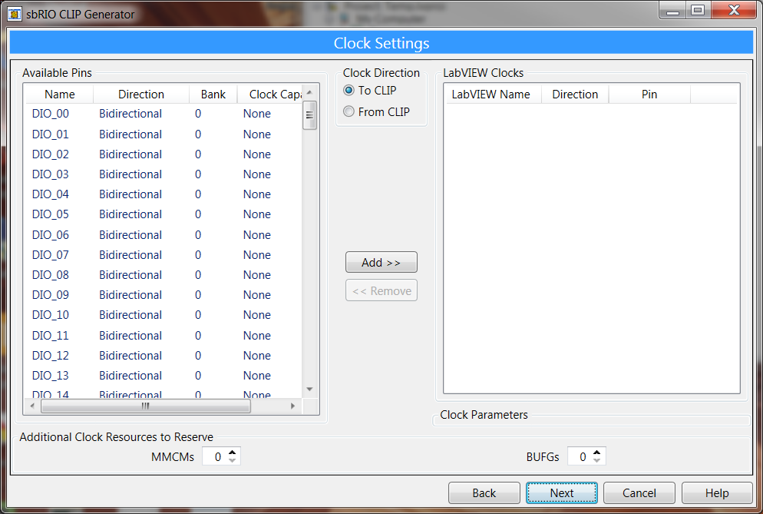
Step 3: Clocks

Slide 13
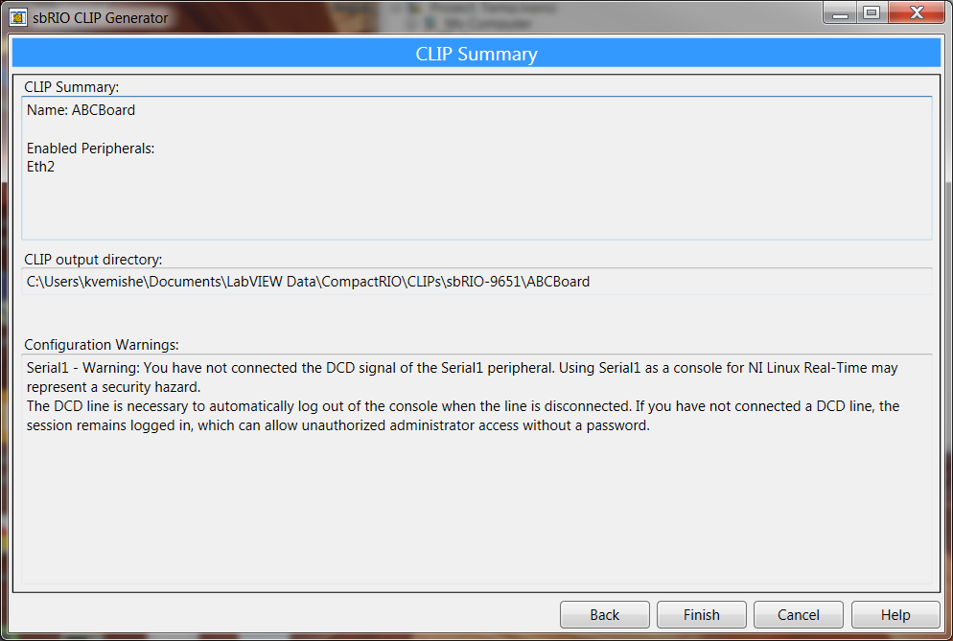
CLIP Output Directory
Clip Files

Slide 14
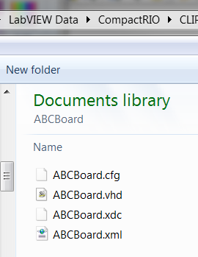
Generated Files in the directory
CLIP Wizard automatically
Generates these files normally at
…\LabVEW Data\CompactRIO\CLIPs

Slide 15
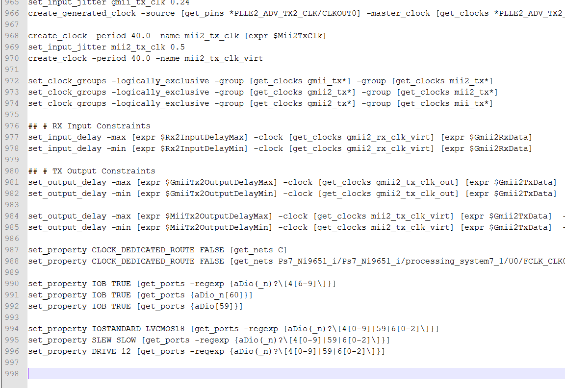
Constraints

Slide 16
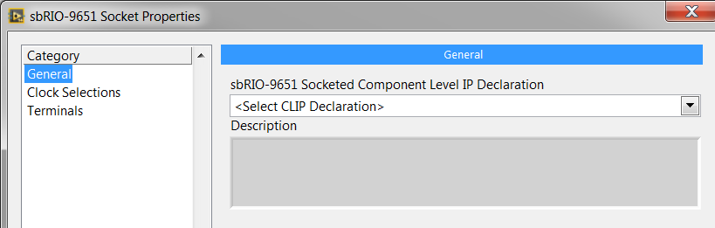
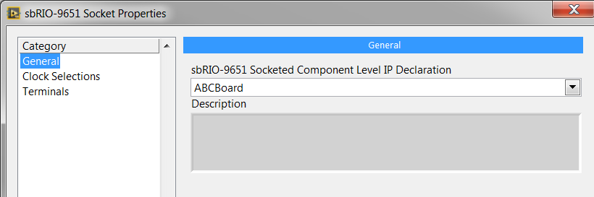
Selecting the socket for SOM

Slide 17
Demos
Create a clk in CLIP and expose it in LVFPGA
Create a clk in LVFPGA and expose it to CLIP
Exercise:
Generate two pulse with timing constraints

Slide 18
Part 2: Modifying the CLIP

Slide 19
Objectives
Generate a Clock in LVFPGA and make it available in CLIP

Slide 20
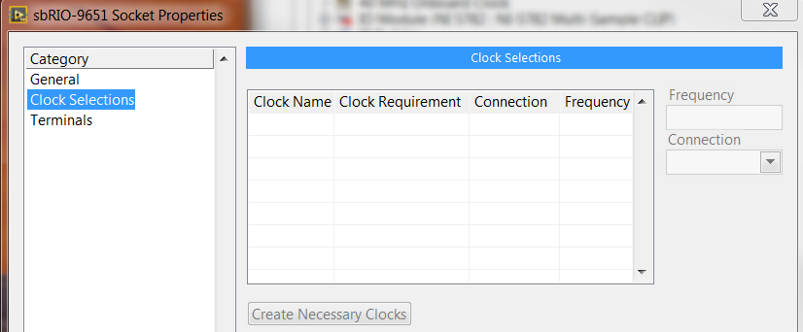
Questions
How to access LVFPGA Clocks in CLIP?
Right now, the clocks section is empty
Notes:
Right Click on Socket CLIP >> Properties >> Clock Selections

Slide 21
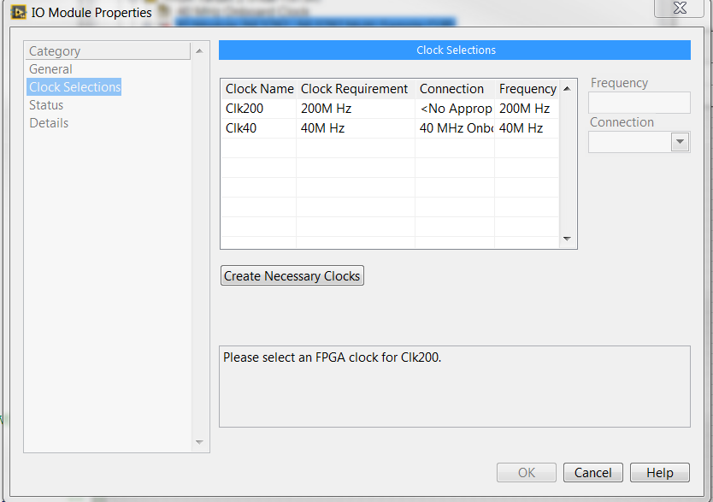
We want to see interface like this…

Slide 22
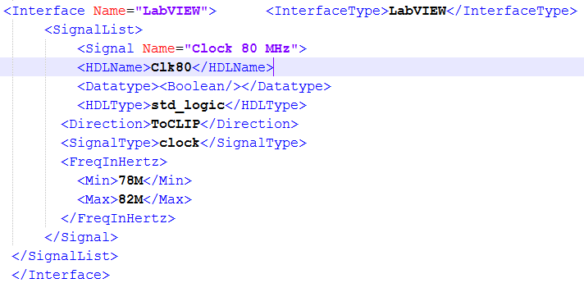
Modifying the XML File to add clock
This implies we are looking for a 80MHz clock from
LVFPGA diagram to CLIP VHDL Code

Slide 23
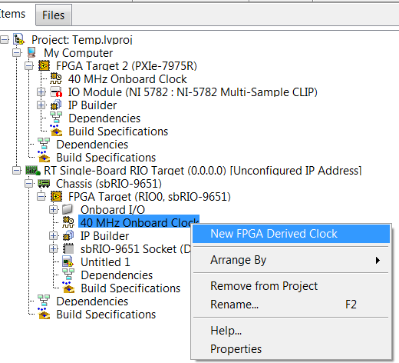
Creating Clocks in LabVIEW FPGA
Create 80MHz clock (2x Onboard Clock)

Slide 24
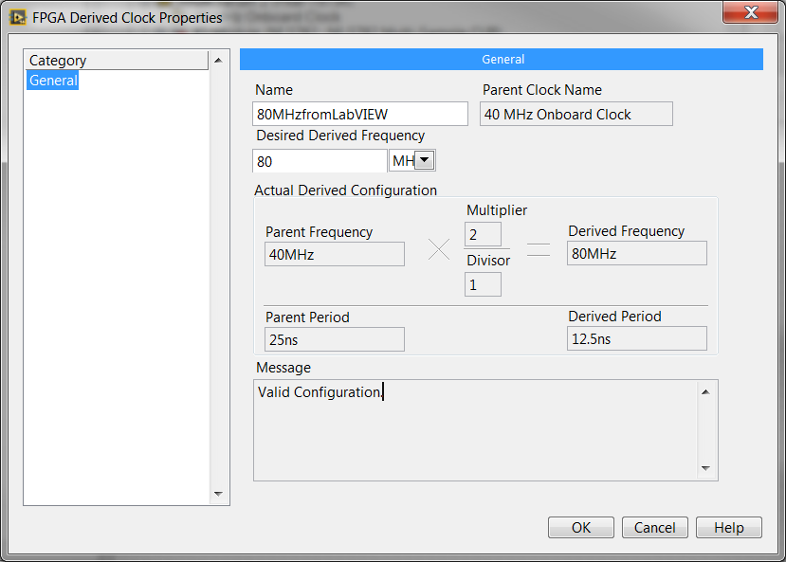
Creating Clocks in LabVIEW FPGA

Slide 25
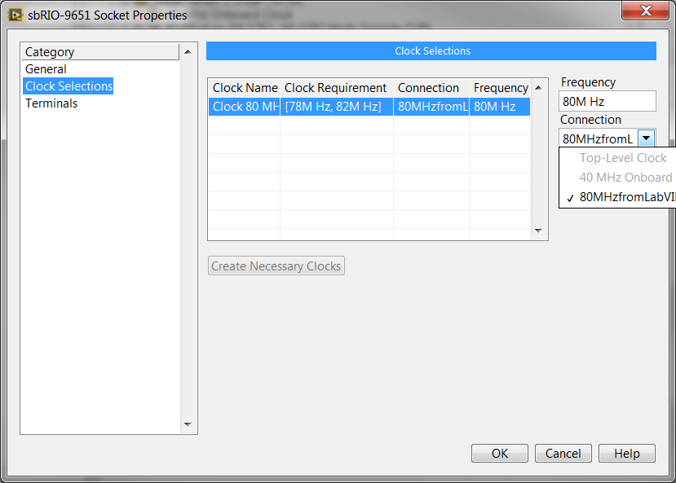
Select Clock from LVFPGA to CLIP

Slide 26
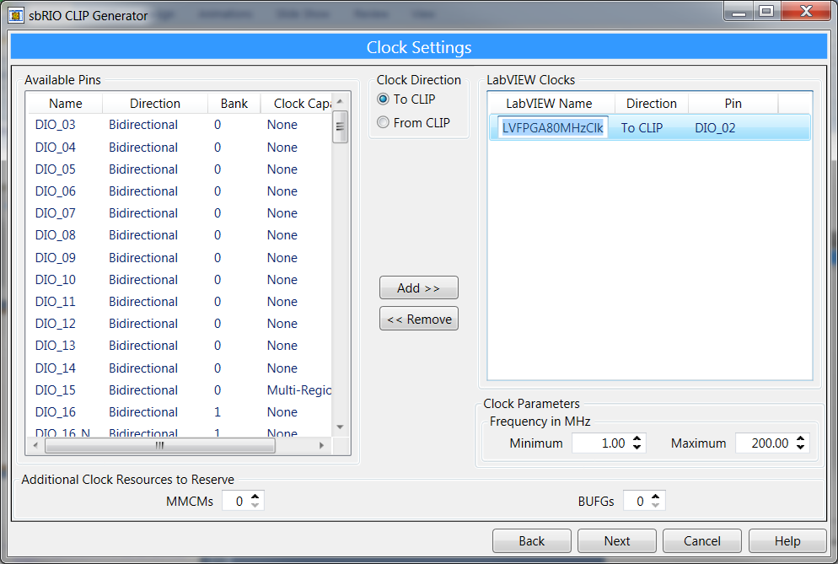
EasyTip
Clock Info

Slide 27
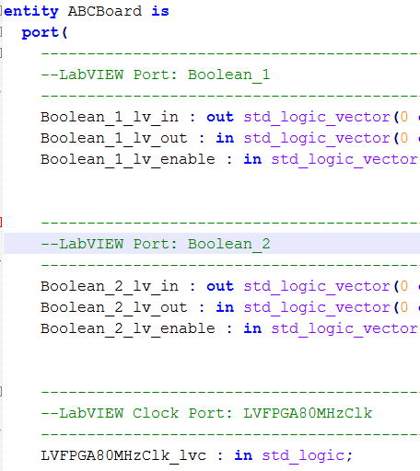
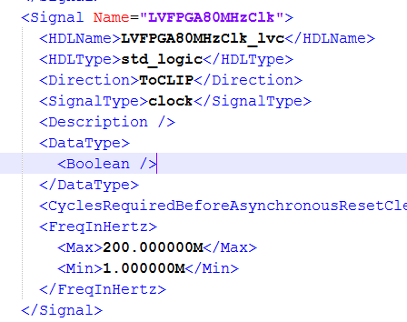
Generated Code
Generated XML Code
Generated VHDL Code

Slide 28
End of Part 2

Slide 29
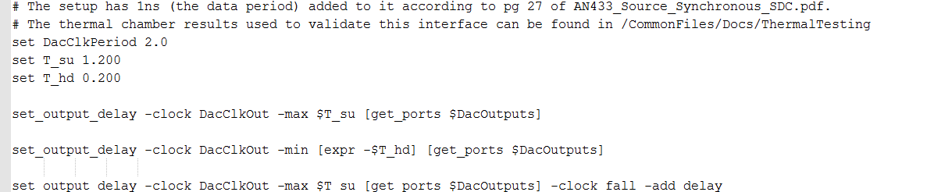
Timing Constraints
I would encourage looking at the VHDL and XML files
for our FlexRIO adapter modules such as 5781, 5761

Slide 30
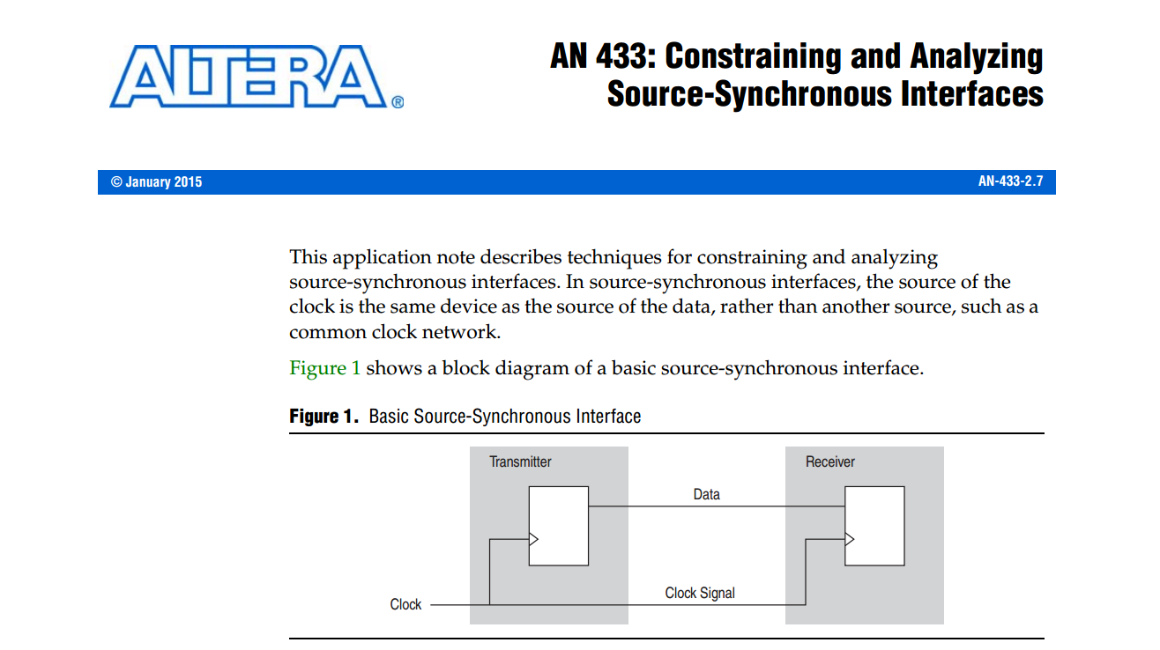
Timing Constraints Document
https://www.altera.com/content/dam/altera-www/global/en_US/pdfs/literature/an/an433.pdf
Search for AN433 source synchronous document

Slide 31
Questions
How do you people access clocks in the CLIP?

